Slide 1
Computational Complexity Hierarchy
EXP-complete:
games like Go, …
EXP
Hard
PSPACE-complete:
QBF, planning, chess (bounded), …
PSPACE
#P-complete/hard:
#SAT, sampling,
probabilistic inference, …
P^#P
PH
NP-complete:
SAT, propositional
reasoning, scheduling,
graph coloring, puzzles, …
NP
P-complete:
circuit-value, …
P
In P:
sorting, shortest path, …
Easy
Note: widely believed hierarchy; know P≠EXP for sure

Slide 2
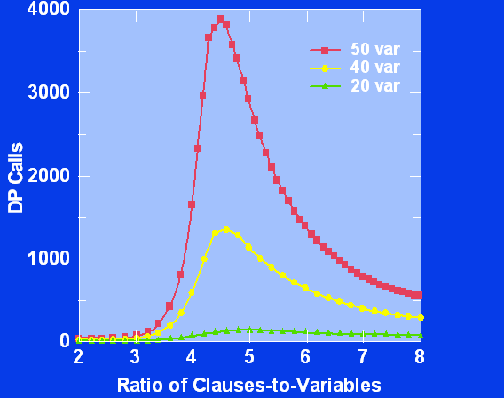
Random 3-SAT
Phase transition
Linear time algs.
Random Walk
DP
DP’
GSAT
Walksat
SP
Mitchell, Selman, and Levesque ’92

Slide 3
Random 3-SAT
Linear time algs.
5.19
Random Walk
5.081
Upper bounds
by combinatorial
arguments
(’92 – ‘15)
DP
4.762
DP’
4.643
GSAT
4.601
Walksat
4.596
SP
4.506

Slide 4
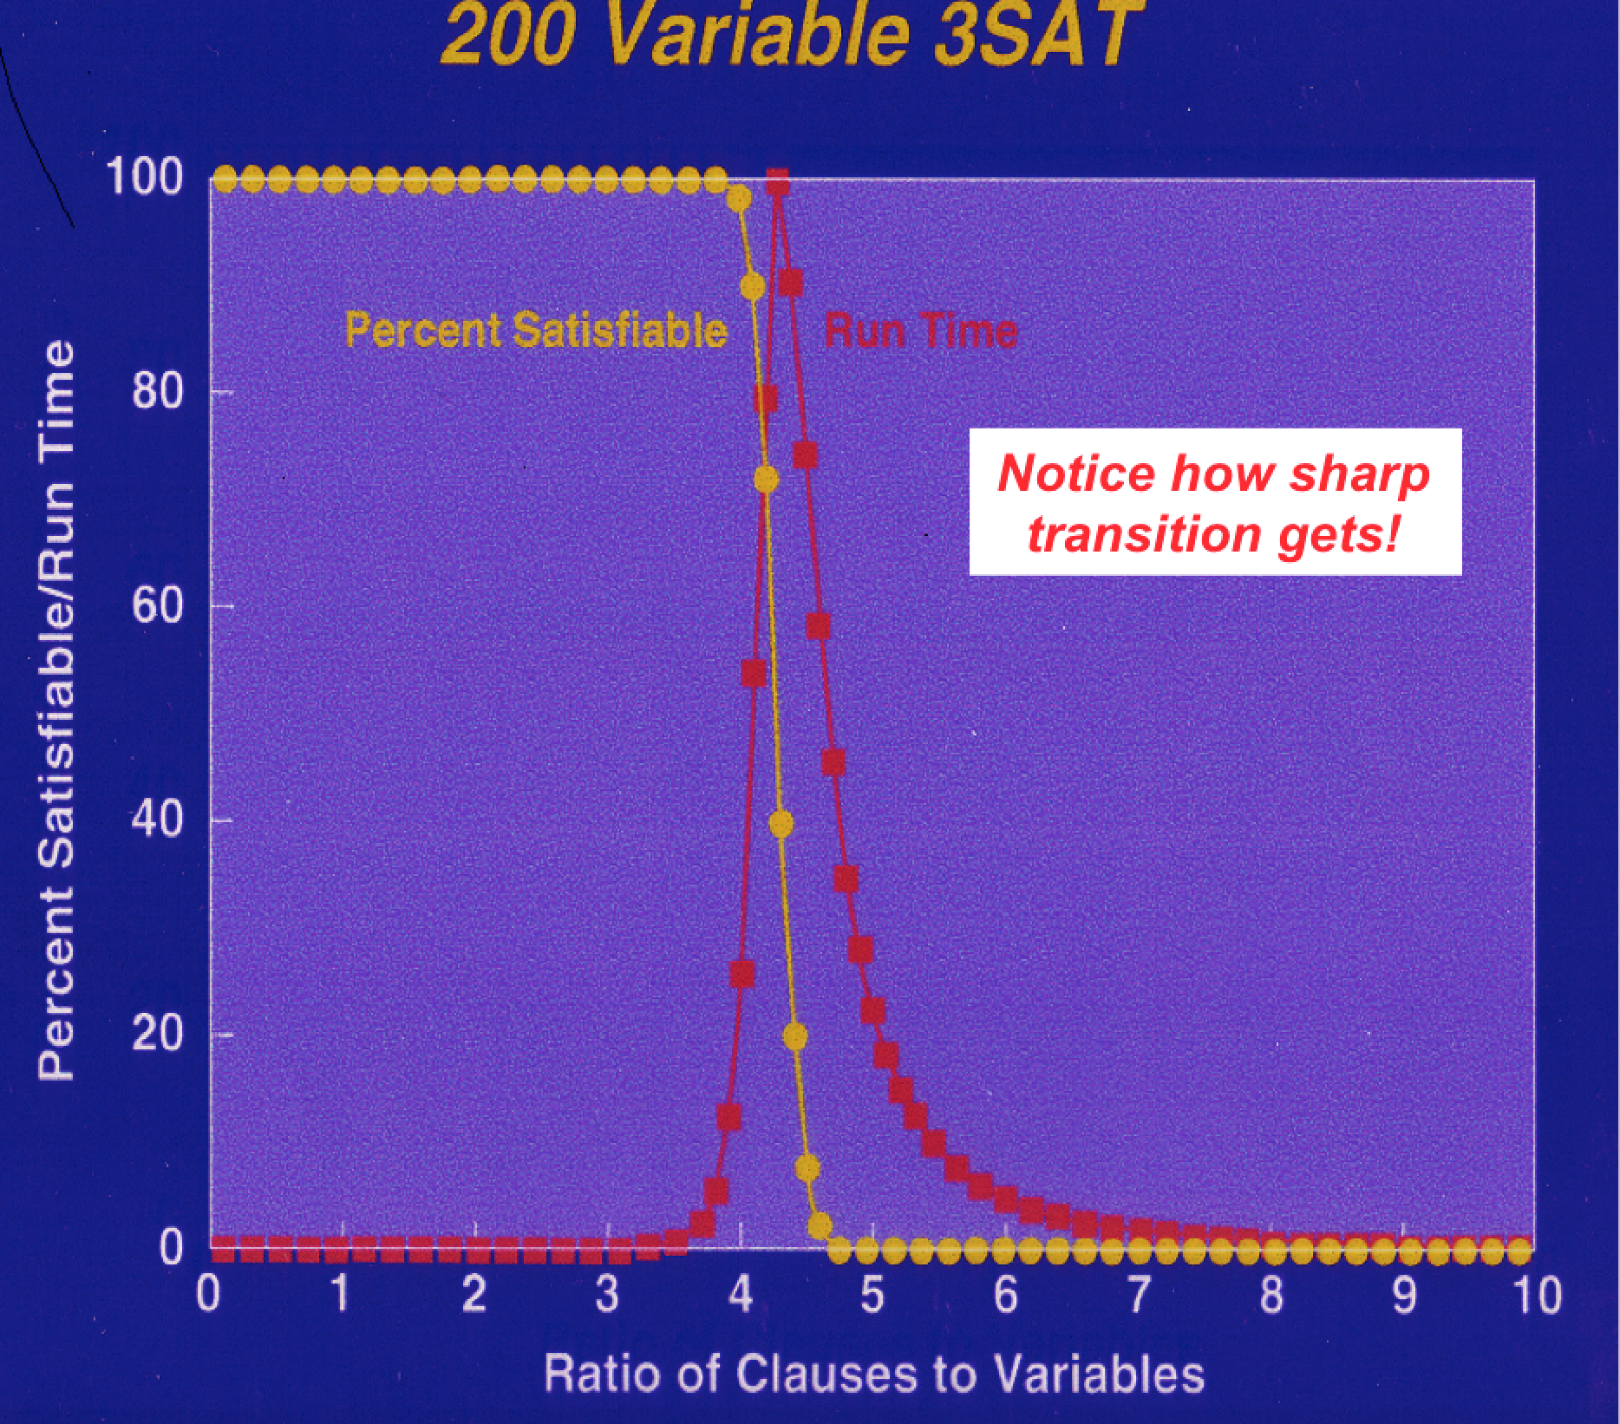
The region of
interest

Slide 5
New types of algorithms for SAT. For example, local search methods (e.g. WalkSAT) and survey propagation (SP), an advanced form of belief propagation.
General insights into practical complexity:
I) Easy-hard-easy patterns and “critically constrained problems”
II) Surprise observation about mixing tractable and intractable structure. E.g. 2SAT and 3SAT. Partly explains the tremendous progress in SAT solving to follow.

Slide 6
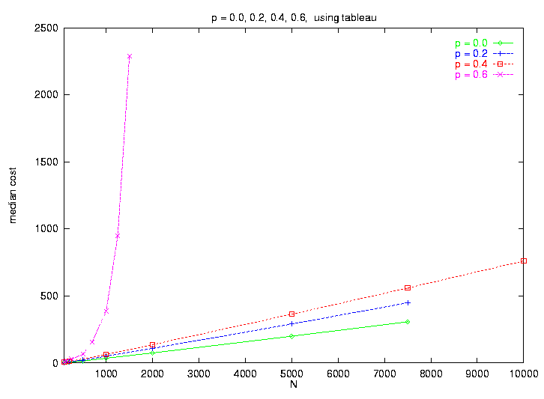
Mixture of tractable and intractable structure
From 2^{O(N)} to O(N) scaling, if sufficient
tractable structure is uncovered!
Millions of variables! ☺
Few 100s vars max
☹
41% 3-SAT --- exponential scaling
Mixing 2-SAT (tractable)
& 3-SAT (intractable) clauses.
Sudden
collapse of
complexity!
Medium cost
40% 3-SAT --- linear scaling
(Monasson, Selman et al. 99)
Num variables

Slide 7
Scaling-Up Reasoning
Principle
I
Key to scalability in reasoning is uncovering
substantial tractable substructure.
Mechanisms:
Constraint propagation (CSP) and unit-propagation (SAT).
Incomplete but highly efficient “sub-inference.”
II) Clause learning (“no-good learning”) adds derived constraints
during search. Helps I).
Conflict Directed Clause Learning (CDCL) SAT solvers.
|||) Randomization, restarts, and heuristic branching.
Backdoor variables.

Slide 8
Scaling-Up Reasoning, cont.
Techniques scale up reasoning from
a few hundred of variables max in the early 90s to
10+ million variable problems for current SAT solvers.
We can now revisit McCarthy’s automated inference
paradigm.
Contributors: [random order] Gomes, Kautz, Sabharwal, Ermon, Kroc, Levesque, Horvitz, Bessiere, Walsh, Gent, Zecchina, Mitchell, Leyton-Brown, Chen, Huang, Rintanen, Hoos, Achlioptas, Cheeseman, Kirkpatrick,Sandholm, Chayes, Brogs, Marques-Silva, Malik, O’Sullivan, Zhang, Lynce, Horvitz, Willams, van Harmelen, van Gelder, Sinz, Dilkina, Yexiang, Darwich, LeBras, Wei Wei, Freuder, Wilson, Kambhampati, Hoffmann, Bierre, Papadimitriou, Bacchus, Beame, Pitassi, McAllester, Weld, Geffner, Samulowitz, Sellmann, Seider, Clarke, Impagliazzo, Manya, Ansotague, Szeider, and others!!

Slide 9
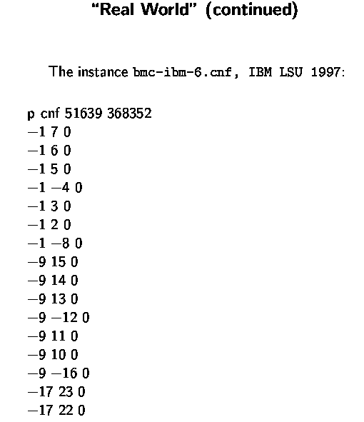
Aside: A Taste of Problem Size
Consider a real world Boolean Satisfiability (SAT) problem,
from formal verification.
I.e., ((not x_1) or x_7)
((not x_1) or x_6)
etc.
x_1, x_2, x_3, etc. our Boolean variables
(set to True or False)
Set x_1 to False ??

Slide 10
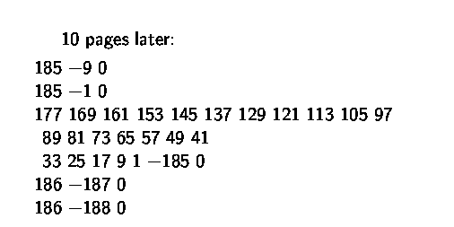
10 pages later:
…
I.e., (x_177 or x_169 or x_161 or x_153 …
x_33 or x_25 or x_17 or x_9 or x_1 or (not x_185))
clauses / constraints are getting more interesting…
Note x_1 …

Slide 11
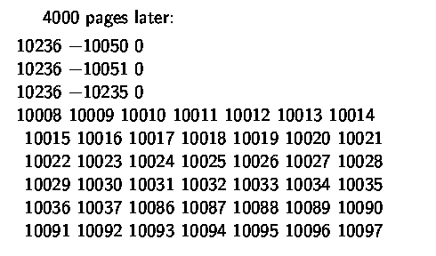
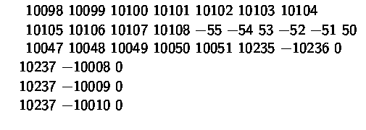
4000 pages later:
…

Slide 12
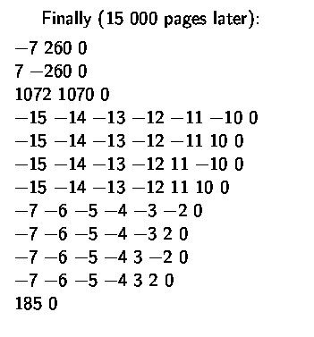

Finally, 15,000 pages later:
Search space of truth assignments:
Current SAT solvers solve this instance in
a few seconds!

